Slide 1
As soon as you come in:
Copy down the date and title from the board
Private Reading
Lesson Objectives
To practice acting in role (S+L AF3)
To have considered the way the themes have developed in these chapters. (AF6)
To be able to explain the symbol of the mockingjay

Slide 2
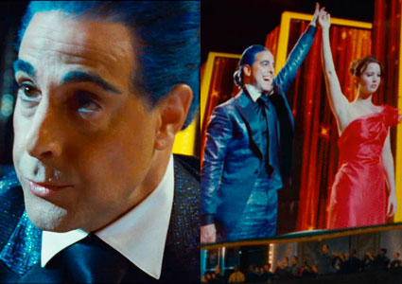
Interviews
Work in pairs.
One of you will play Ceasar
Flickerman and one of you will be
one of the tributes whose
interview we didn’t see in the
book.
Prepare a role play of their
interview.
You may want to write down a list
of questions and answers but you
don’t have to.

Slide 3



Rue
District 11
Works on a farm
Only 12 years old
Cato and Clove
District 2 (rich)
Careers – specially trained for the Hunger Games, volunteers
Top of page 152

Slide 4
Peer Feedback
Do they look like they are talking naturally rather than reading from a book?
Do their questions and answers fit in with the events of the book?
Are they in role? Can you suggest any other ways they could change their voice/actions to get more in character?
Are they speaking loudly and clearly?

Slide 5

Think-Pair-Share
What does the Mockingjay symbolise?

Slide 6
Themes
Work as a table to think about whether there
is anything to add to your themes/motifs
pages from the chapters we’ve read
recently.

